Slide 1
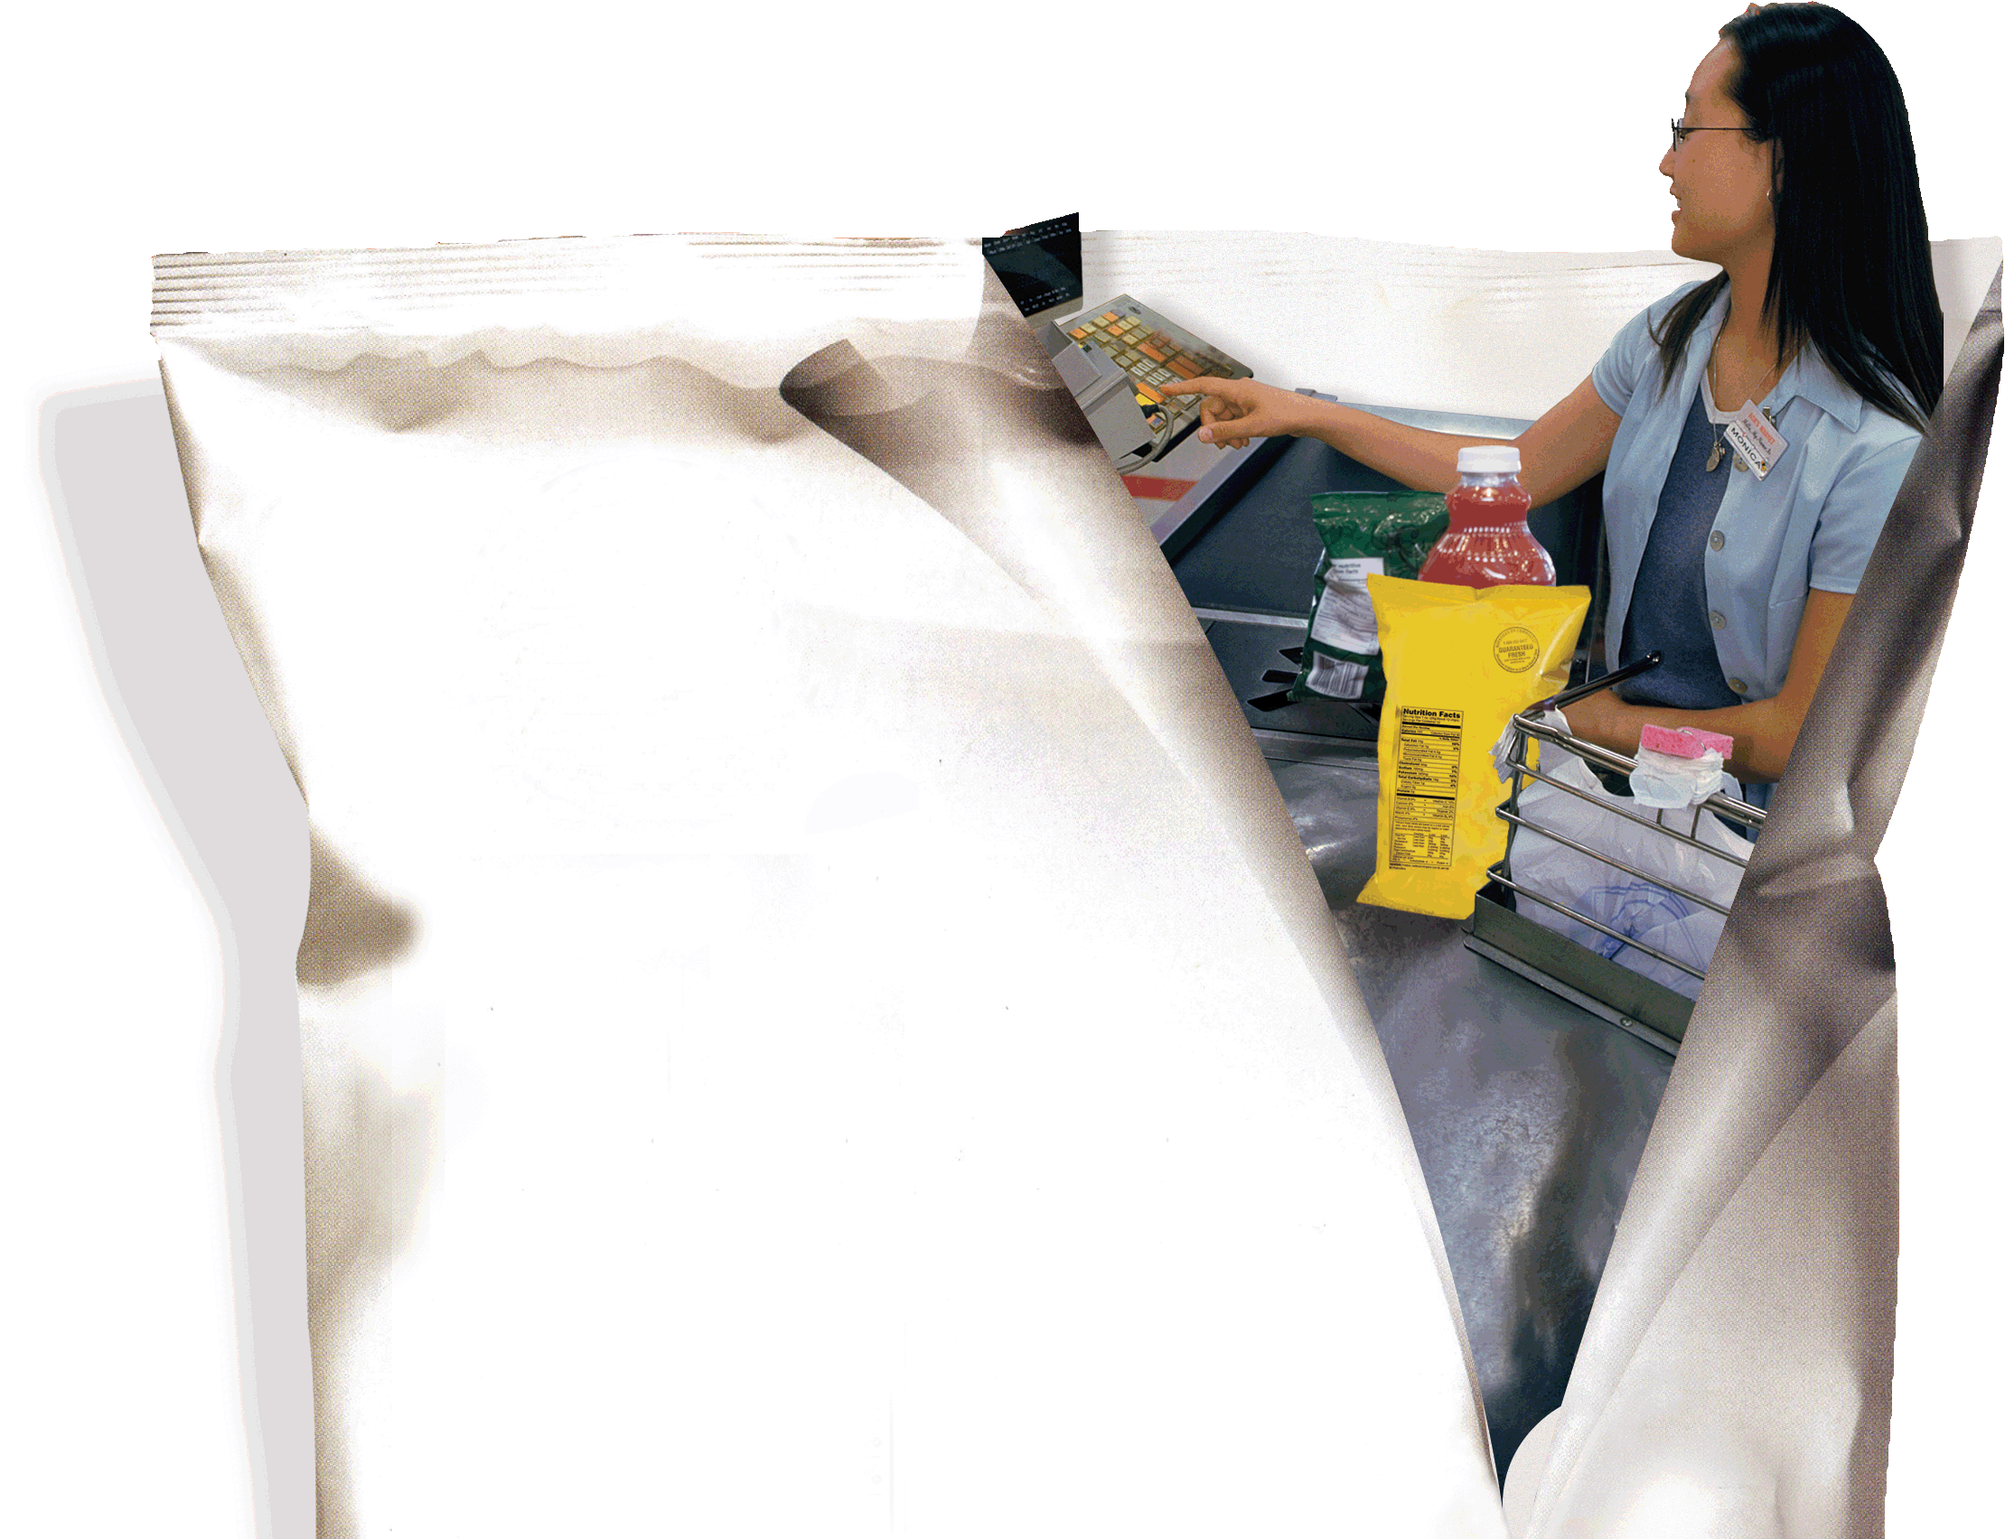
D
Waiting-Line Models
PowerPoint presentation to accompany
Heizer and Render
Operations Management, 10e
Principles of Operations Management, 8e
PowerPoint slides by Jeff Heyl

Slide 2
Outline
Queuing Theory
Characteristics of a Waiting-Line System
  Arrival Characteristics
  Waiting-Line Characteristics
  Service Characteristics
  Measuring a Queue’s Performance
Queuing Costs

Slide 3
Outline – Continued
The Variety of Queuing Models
  Model A(M/M/1): Single-Channel Queuing Model with Poisson Arrivals and Exponential Service Times
  Model B(M/M/S): Multiple-Channel Queuing Model
  Model C(M/D/1): Constant-Service-Time Model
  Little’s Law
  Model D: Limited-Population Model

Slide 4
Outline – Continued
Other Queuing Approaches

Slide 5
Learning Objectives
When you complete this module you should be able to:
Describe the characteristics of arrivals, waiting lines, and service systems
Apply the single-channel queuing model equations
Conduct a cost analysis for a waiting line

Slide 6
Learning Objectives
When you complete this module you should be able to:
Apply the multiple-channel queuing model formulas
Apply the constant-service-time model equations
Perform a limited-population model analysis

Slide 7
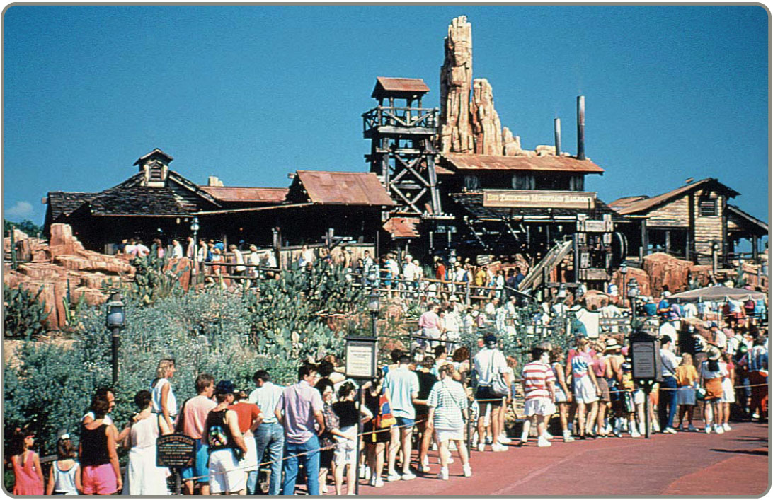
Queuing Theory
The study of waiting lines
Waiting lines are common situations
Useful in both
manufacturing
and service
areas

Slide 8
Common Queuing Situations
Situation | Arrivals in Queue | Service Process
Supermarket | Grocery shoppers | Checkout clerks at cash register
Highway toll booth | Automobiles | Collection of tolls at booth
Doctor’s office | Patients | Treatment by doctors and nurses
Computer system | Programs to be run | Computer processes jobs
Telephone company | Callers | Switching equipment to forward calls
Bank | Customer | Transactions handled by teller
Machine maintenance | Broken machines | Repair people fix machines
Harbor | Ships and barges | Dock workers load and unload
Table D.1
Notes:
This slide provides some reasons that capacity is an issue. The following slides guide a discussion of capacity.

Slide 9
Characteristics of Waiting-Line Systems
Arrivals or inputs to the system
  Population size, behavior, statistical distribution
Queue discipline, or the waiting line itself
  Limited or unlimited in length, discipline of people or items in it
The service facility
  Design, statistical distribution of service times
Notes:
This slide provides some reasons that capacity is an issue. The following slides guide a discussion of capacity.

Slide 10
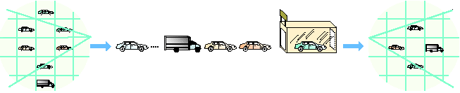
Parts of a Waiting Line
Population of
dirty cars
Arrivals
from the
general
population …
Queue
(waiting line)
Service
facility
Exit the system
Dave’s
Car Wash
Enter
Exit
Arrivals to the system
In the system
Exit the system
Arrival Characteristics
Size of the population
Behavior of arrivals
Statistical distribution of arrivals
Waiting Line Characteristics
Limited vs. unlimited
Queue discipline
Service Characteristics
Service design
Statistical distribution of service
Figure D.1
Notes:
This slide can be used to frame a discussion of capacity.
Points to be made might include:
- capacity definition and measurement is necessary if we are to develop a production schedule
- while a process may have “maximum” capacity, many factors prevent us from achieving that capacity on a continuous basis.
Students should be asked to suggest factors which might prevent one from achieving maximum capacity.

Slide 11
Arrival Characteristics
Size of the population
  Unlimited (infinite) or limited (finite)
Pattern of arrivals
  Scheduled or random, often a Poisson distribution
Behavior of arrivals
  Wait in the queue and do not switch lines
  No balking or reneging
Notes:
This slide can be used to frame a discussion of capacity.
Points to be made might include:
- capacity definition and measurement is necessary if we are to develop a production schedule
- while a process may have “maximum” capacity, many factors prevent us from achieving that capacity on a continuous basis.
Students should be asked to suggest factors which might prevent one from achieving maximum capacity.

Slide 12
Poisson Distribution
e^{-λ}λ^{x}
x!
P(x) = for x = 0, 1, 2, 3, 4, …
where P(x) = probability of x arrivals
x = number of arrivals per unit of time
λ = average arrival rate
e = 2.7183 (which is the base of the natural logarithms)
Notes:
This slide can be used to frame a discussion of capacity.
Points to be made might include:
- capacity definition and measurement is necessary if we are to develop a production schedule
- while a process may have “maximum” capacity, many factors prevent us from achieving that capacity on a continuous basis.
Students should be asked to suggest factors which might prevent one from achieving maximum capacity.

Slide 13
Poisson Distribution
e^{-λ}λ^{x}
x!
Probability = P(x) =
0.25 –
0.02 –
0.15 –
0.10 –
0.05 –
–
0.25 –
0.02 –
0.15 –
0.10 –
0.05 –
–
Probability
Probability
0
1
2
3
4
5
6
7
8
9
x
0
1
2
3
4
5
6
7
8
9
10
11
x
Distribution for λ = 2
Distribution for λ = 4
Figure D.2
Notes:
This slide can be used to frame a discussion of capacity.
Points to be made might include:
- capacity definition and measurement is necessary if we are to develop a production schedule
- while a process may have “maximum” capacity, many factors prevent us from achieving that capacity on a continuous basis.
Students should be asked to suggest factors which might prevent one from achieving maximum capacity.

Slide 14
Waiting-Line Characteristics
Limited or unlimited queue length
Queue discipline - first-in, first-out (FIFO) is most common
Other priority rules may be used in special circumstances
Notes:
This slide can be used to frame a discussion of capacity.
Points to be made might include:
- capacity definition and measurement is necessary if we are to develop a production schedule
- while a process may have “maximum” capacity, many factors prevent us from achieving that capacity on a continuous basis.
Students should be asked to suggest factors which might prevent one from achieving maximum capacity.

Slide 15
Service Characteristics
Queuing system designs
  Single-channel system, multiple-channel system
  Single-phase system, multiphase system
Service time distribution
  Constant service time
  Random service times, usually a negative exponential distribution
Notes:
This slide can be used to frame a discussion of capacity.
Points to be made might include:
- capacity definition and measurement is necessary if we are to develop a production schedule
- while a process may have “maximum” capacity, many factors prevent us from achieving that capacity on a continuous basis.
Students should be asked to suggest factors which might prevent one from achieving maximum capacity.

Slide 16
Queuing System Designs
A family dentist’s office
Queue
Arrivals
Service facility
Departures
after service
Single-channel, single-phase system
A McDonald’s dual window drive-through
Queue
Arrivals
Phase 1 service facility
Phase 2 service facility
Departures
after service
Single-channel, multiphase system
Figure D.3
Notes:
This slide can be used to frame a discussion of capacity.
Points to be made might include:
- capacity definition and measurement is necessary if we are to develop a production schedule
- while a process may have “maximum” capacity, many factors prevent us from achieving that capacity on a continuous basis.
Students should be asked to suggest factors which might prevent one from achieving maximum capacity.

Slide 17
Queuing System Designs
Most bank and post office service windows
Service facility
Channel 1
Queue
Arrivals
Service facility
Channel 2
Departures
after service
Service facility
Channel 3
Multi-channel, single-phase system
Figure D.3
Notes:
This slide can be used to frame a discussion of capacity.
Points to be made might include:
- capacity definition and measurement is necessary if we are to develop a production schedule
- while a process may have “maximum” capacity, many factors prevent us from achieving that capacity on a continuous basis.
Students should be asked to suggest factors which might prevent one from achieving maximum capacity.

Slide 18
Queuing System Designs
Some college registrations
Phase 1 service facility
Channel 1
Phase 2 service facility
Channel 1
Queue
Arrivals
Departures
after service
Phase 1 service facility
Channel 2
Phase 2 service facility
Channel 2
Multi-channel, multiphase system
Figure D.3
Notes:
This slide can be used to frame a discussion of capacity.
Points to be made might include:
- capacity definition and measurement is necessary if we are to develop a production schedule
- while a process may have “maximum” capacity, many factors prevent us from achieving that capacity on a continuous basis.
Students should be asked to suggest factors which might prevent one from achieving maximum capacity.

Slide 19
Negative Exponential Distribution
Probability that service time is greater than t = e^{-µt} for t ≥ 1
1.0 –
0.9 –
0.8 –
0.7 –
0.6 –
0.5 –
0.4 –
0.3 –
0.2 –
0.1 –
0.0 –
µ = Average service rate
e = 2.7183
Average service rate (µ) = 3 customers per hour
⇒ Average service time = 20 minutes per customer
Probability that service time ≥ 1
Average service rate (µ) =
1 customer per hour
| | | | | | | | | | | | |
0.00 0.25 0.50 0.75 1.00 1.25 1.50 1.75 2.00 2.25 2.50 2.75 3.00
Figure D.4
Time t (hours)
Notes:
This slide can be used to frame a discussion of capacity.
Points to be made might include:
- capacity definition and measurement is necessary if we are to develop a production schedule
- while a process may have “maximum” capacity, many factors prevent us from achieving that capacity on a continuous basis.
Students should be asked to suggest factors which might prevent one from achieving maximum capacity.

Slide 20
Measuring Queue Performance
Average time that each customer or object spends in the queue
Average queue length
Average time each customer spends in the system
Average number of customers in the system
Probability that the service facility will be idle
Utilization factor for the system
Probability of a specific number of customers in the system
Notes:
This slide can be used to frame a discussion of capacity.
Points to be made might include:
- capacity definition and measurement is necessary if we are to develop a production schedule
- while a process may have “maximum” capacity, many factors prevent us from achieving that capacity on a continuous basis.
Students should be asked to suggest factors which might prevent one from achieving maximum capacity.

Slide 21
Queuing Costs
Cost
Minimum
Total
cost
Total expected cost
Cost of providing service
Cost of waiting time
Low level
of service
Optimal
service level
High level
of service
Figure D.5
Notes:
This slide can be used to frame a discussion of capacity.
Points to be made might include:
- capacity definition and measurement is necessary if we are to develop a production schedule
- while a process may have “maximum” capacity, many factors prevent us from achieving that capacity on a continuous basis.
Students should be asked to suggest factors which might prevent one from achieving maximum capacity.

Slide 22
Queuing Models
The four queuing models here all assume:
Poisson distribution arrivals
FIFO discipline
A single-service phase
Notes:
This slide can be used to frame a discussion of capacity.
Points to be made might include:
- capacity definition and measurement is necessary if we are to develop a production schedule
- while a process may have “maximum” capacity, many factors prevent us from achieving that capacity on a continuous basis.
Students should be asked to suggest factors which might prevent one from achieving maximum capacity.

Slide 23
Queuing Models
Model Name Example
A Single-channel Information counter
system at department store
(M/M/1)
Number Number Arrival Service
of of Rate Time Population Queue
Channels Phases Pattern Pattern Size Discipline
Single Single Poisson Exponential Unlimited FIFO
Table D.2
Notes:
This slide can be used to frame a discussion of capacity.
Points to be made might include:
- capacity definition and measurement is necessary if we are to develop a production schedule
- while a process may have “maximum” capacity, many factors prevent us from achieving that capacity on a continuous basis.
Students should be asked to suggest factors which might prevent one from achieving maximum capacity.

Slide 24
Queuing Models
Model Name Example
B Multichannel Airline ticket
(M/M/S) counter
Number Number Arrival Service
of of Rate Time Population Queue
Channels Phases Pattern Pattern Size Discipline
Multi- Single Poisson Exponential Unlimited FIFO
channel
Table D.2
Notes:
This slide can be used to frame a discussion of capacity.
Points to be made might include:
- capacity definition and measurement is necessary if we are to develop a production schedule
- while a process may have “maximum” capacity, many factors prevent us from achieving that capacity on a continuous basis.
Students should be asked to suggest factors which might prevent one from achieving maximum capacity.

Slide 25
Queuing Models
Model Name Example
C Constant- Automated car
service wash
(M/D/1)
Number Number Arrival Service
of of Rate Time Population Queue
Channels Phases Pattern Pattern Size Discipline
Single Single Poisson Constant Unlimited FIFO
Table D.2
Notes:
This slide can be used to frame a discussion of capacity.
Points to be made might include:
- capacity definition and measurement is necessary if we are to develop a production schedule
- while a process may have “maximum” capacity, many factors prevent us from achieving that capacity on a continuous basis.
Students should be asked to suggest factors which might prevent one from achieving maximum capacity.

Slide 26
Queuing Models
Model Name Example
D Limited Shop with only a
population dozen machines
(finite population) that might break
Number Number Arrival Service
of of Rate Time Population Queue
Channels Phases Pattern Pattern Size Discipline
Single Single Poisson Exponential Limited FIFO
Table D.2
Notes:
This slide can be used to frame a discussion of capacity.
Points to be made might include:
- capacity definition and measurement is necessary if we are to develop a production schedule
- while a process may have “maximum” capacity, many factors prevent us from achieving that capacity on a continuous basis.
Students should be asked to suggest factors which might prevent one from achieving maximum capacity.

Slide 27
Model A – Single-Channel
Arrivals are served on a FIFO basis and every arrival waits to be served regardless of the length of the queue
Arrivals are independent of preceding arrivals but the average number of arrivals does not change over time
Arrivals are described by a Poisson probability distribution and come from an infinite population
Notes:
This slide can be used to frame a discussion of capacity.
Points to be made might include:
- capacity definition and measurement is necessary if we are to develop a production schedule
- while a process may have “maximum” capacity, many factors prevent us from achieving that capacity on a continuous basis.
Students should be asked to suggest factors which might prevent one from achieving maximum capacity.

Slide 28
Model A – Single-Channel
Service times vary from one customer to the next and are independent of one another, but their average rate is known
Service times occur according to the negative exponential distribution
The service rate is faster than the arrival rate
Notes:
This slide can be used to frame a discussion of capacity.
Points to be made might include:
- capacity definition and measurement is necessary if we are to develop a production schedule
- while a process may have “maximum” capacity, many factors prevent us from achieving that capacity on a continuous basis.
Students should be asked to suggest factors which might prevent one from achieving maximum capacity.

Slide 29
Model A – Single-Channel
λ = Mean number of arrivals per time period
µ = Mean number of units served per time period
L_{s} = Average number of units (customers) in the system (waiting and being served)
=
W_{s} = Average time a unit spends in the system (waiting time plus service time)
=
λ
µ – λ
1
µ – λ
Table D.3
Notes:
This slide can be used to frame a discussion of capacity.
Points to be made might include:
- capacity definition and measurement is necessary if we are to develop a production schedule
- while a process may have “maximum” capacity, many factors prevent us from achieving that capacity on a continuous basis.
Students should be asked to suggest factors which might prevent one from achieving maximum capacity.

Slide 30
Model A – Single-Channel
L_{q} = Average number of units waiting in the queue
=
W_{q} = Average time a unit spends waiting in the queue
=
ρ = Utilization factor for the system
=
λ²
µ(µ – λ)
λ
µ(µ – λ)
λ
µ
Table D.3
Notes:
This slide can be used to frame a discussion of capacity.
Points to be made might include:
- capacity definition and measurement is necessary if we are to develop a production schedule
- while a process may have “maximum” capacity, many factors prevent us from achieving that capacity on a continuous basis.
Students should be asked to suggest factors which might prevent one from achieving maximum capacity.

Slide 31
Model A – Single-Channel
P₀ = Probability of 0 units in the system (that is, the service unit is idle)
= 1 –
P_{n > k} = Probability of more than k units in the system, where n is the number of units in the system
=
λ
µ
λ
µ
k + 1
Table D.3
Notes:
This slide can be used to frame a discussion of capacity.
Points to be made might include:
- capacity definition and measurement is necessary if we are to develop a production schedule
- while a process may have “maximum” capacity, many factors prevent us from achieving that capacity on a continuous basis.
Students should be asked to suggest factors which might prevent one from achieving maximum capacity.

Slide 32
Single-Channel Example
λ = 2 cars arriving/hour µ = 3 cars serviced/hour
L_{s} = = = 2 cars in the system on average
W_{s} = = = 1 hour average waiting time in the system
L_{q} = = = 1.33 cars waiting in line
λ
µ – λ
2
3 - 2
1
µ – λ
1
3 - 2
λ²
µ(µ – λ)
2²
3(3 - 2)
Notes:
This slide can be used to frame a discussion of capacity.
Points to be made might include:
- capacity definition and measurement is necessary if we are to develop a production schedule
- while a process may have “maximum” capacity, many factors prevent us from achieving that capacity on a continuous basis.
Students should be asked to suggest factors which might prevent one from achieving maximum capacity.

Slide 33
Single-Channel Example
λ = 2 cars arriving/hour µ = 3 cars serviced/hour
λ
µ(µ – λ)
2
3(3 - 2)
W_{q} = = = 2/3 hour = 40 minute average waiting time
ρ = λ/µ = 2/3 = 66.6% of time mechanic is busy
λ
µ
P₀ = 1 - = .33 probability there are 0 cars in the system
Notes:
This slide can be used to frame a discussion of capacity.
Points to be made might include:
- capacity definition and measurement is necessary if we are to develop a production schedule
- while a process may have “maximum” capacity, many factors prevent us from achieving that capacity on a continuous basis.
Students should be asked to suggest factors which might prevent one from achieving maximum capacity.

Slide 34
Single-Channel Example
Probability of more than k Cars in the System
k P_{n > k} = (2/3)^{k + 1}
0 .667 ← Note that this is equal to 1 - P₀ = 1 - .33
1 .444
2 .296
3 .198 ← Implies that there is a 19.8% chance that more than 3 cars are in the system
4 .132
5 .088
6 .058
7 .039
Notes:
This slide can be used to frame a discussion of capacity.
Points to be made might include:
- capacity definition and measurement is necessary if we are to develop a production schedule
- while a process may have “maximum” capacity, many factors prevent us from achieving that capacity on a continuous basis.
Students should be asked to suggest factors which might prevent one from achieving maximum capacity.

Slide 35
Single-Channel Economics
Customer dissatisfaction
and lost goodwill = $10 per hour
W_{q} = 2/3 hour
Total arrivals = 16 per day
Mechanic’s salary = $56 per day
Total hours customers spend waiting per day
2
3
2
3
= (16) = 10 hours
2
3
Customer waiting-time cost = $10 10 = $106.67
Total expected costs = $106.67 + $56 = $162.67
Notes:
This slide can be used to frame a discussion of capacity.
Points to be made might include:
- capacity definition and measurement is necessary if we are to develop a production schedule
- while a process may have “maximum” capacity, many factors prevent us from achieving that capacity on a continuous basis.
Students should be asked to suggest factors which might prevent one from achieving maximum capacity.

Slide 36
Multi-Channel Model
M = number of channels open
λ = average arrival rate
µ = average service rate at each channel
1
P₀ = for Mµ > λ
M – 1
1
n!
λ
µ
n
1
M!
λ
µ
M
Mµ
Mµ - λ
∑
+
n = 0
M
λµ(λ/µ)
λ
µ
L_{s} = P₀ +
2
(M - 1)!(Mµ - λ)
Table D.4
Notes:
This slide can be used to frame a discussion of capacity.
Points to be made might include:
- capacity definition and measurement is necessary if we are to develop a production schedule
- while a process may have “maximum” capacity, many factors prevent us from achieving that capacity on a continuous basis.
Students should be asked to suggest factors which might prevent one from achieving maximum capacity.

Slide 37
Multi-Channel Model
M
L_{s}
λ
λµ(λ/µ)
1
µ
W_{s} = P₀ + =
2
(M - 1)!(Mµ - λ)
λ
µ
L_{q} = L_{s} –
1
µ
L_{q}
λ
W_{q} = W_{s} – =
Table D.4
Notes:
This slide can be used to frame a discussion of capacity.
Points to be made might include:
- capacity definition and measurement is necessary if we are to develop a production schedule
- while a process may have “maximum” capacity, many factors prevent us from achieving that capacity on a continuous basis.
Students should be asked to suggest factors which might prevent one from achieving maximum capacity.

Slide 38
Multi-Channel Example
λ = 2 µ = 3 M = 2
1
1
2
P₀ = =
1
n
2
2(3)
2(3) - 2
∑
1
n!
2
3
1
2!
2
3
+
n = 0
(2)(3(2/3)²
1
2
2
3
3
4
L_{s} = + =
1! 2(3) - 2 ²
3/4
2
3
8
3
4
2
3
1
12
.083
2
W_{s} = =
L_{q} = – =
W_{q} = = .0415
Notes:
This slide can be used to frame a discussion of capacity.
Points to be made might include:
- capacity definition and measurement is necessary if we are to develop a production schedule
- while a process may have “maximum” capacity, many factors prevent us from achieving that capacity on a continuous basis.
Students should be asked to suggest factors which might prevent one from achieving maximum capacity.

Slide 39
Multi-Channel Example
 | Single Channel | Two Channels
P₀ | .33 | .5
L_{s} | 2 cars | .75 cars
W_{s} | 60 minutes | 22.5 minutes
L_{q} | 1.33 cars | .083 cars
W_{q} | 40 minutes | 2.5 minutes
Notes:
This slide can be used to frame a discussion of capacity.
Points to be made might include:
- capacity definition and measurement is necessary if we are to develop a production schedule
- while a process may have “maximum” capacity, many factors prevent us from achieving that capacity on a continuous basis.
Students should be asked to suggest factors which might prevent one from achieving maximum capacity.

Slide 40
Waiting Line Tables
Poisson Arrivals, Exponential Service Times
Number of Service Channels, M
ρ | 1 | 2 | 3 | 4 | 5
.10 | .0111
.25 | .0833 | .0039
.50 | .5000 | .0333 | .0030
.75 | 2.2500 | .1227 | .0147
.90 | 3.1000 | .2285 | .0300 | .0041
1.0 |  | .3333 | .0454 | .0067
1.6 |  | 2.8444 | .3128 | .0604 | .0121
2.0 |  |  | .8888 | .1739 | .0398
2.6 |  |  | 4.9322 | .6581 | .1609
3.0 |  |  |  | 1.5282 | .3541
4.0 |  |  |  |  | 2.2164
Table D.5
Notes:
This slide can be used to frame a discussion of capacity.
Points to be made might include:
- capacity definition and measurement is necessary if we are to develop a production schedule
- while a process may have “maximum” capacity, many factors prevent us from achieving that capacity on a continuous basis.
Students should be asked to suggest factors which might prevent one from achieving maximum capacity.

Slide 41
Waiting Line Table Example
Bank tellers and customers
λ = 18, µ = 20
L_{q}
λ
Utilization factor ρ = λ/µ = .90
W_{q} =
From Table D.5
Number of service windows | M | Number in queue | Time in queue
1 window | 1 | 8.1 | .45 hrs, 27 minutes
2 windows | 2 | .2285 | .0127 hrs, ¾ minute
3 windows | 3 | .03 | .0017 hrs, 6 seconds
4 windows | 4 | .0041 | .0003 hrs, 1 second

Slide 42
Constant-Service Model
Average length
of queue
λ²
2µ(µ – λ)
L_{q} =
Average waiting time
in queue
λ
2µ(µ – λ)
W_{q} =
Average number of
customers in system
λ
µ
L_{s} = L_{q} +
Average time
in the system
1
µ
W_{s} = W_{q} +
Table D.6
Notes:
This slide can be used to frame a discussion of capacity.
Points to be made might include:
- capacity definition and measurement is necessary if we are to develop a production schedule
- while a process may have “maximum” capacity, many factors prevent us from achieving that capacity on a continuous basis.
Students should be asked to suggest factors which might prevent one from achieving maximum capacity.

Slide 43
Constant-Service Example
Trucks currently wait 15 minutes on average
Truck and driver cost $60 per hour
Automated compactor service rate (µ) = 12 trucks per hour
Arrival rate (λ) = 8 per hour
Compactor costs $3 per truck
Current waiting cost per trip = (1/4 hr)($60) = $15 /trip
8
2(12)(12 – 8)
1
12
W_{q} = = hour
Waiting cost/trip
with compactor
= (1/12 hr wait)($60/hr cost) = $ 5 /trip
Savings with
new equipment
= $15 (current) – $5(new) = $10 /trip
Cost of new equipment amortized = $ 3 /trip
Net savings = $ 7 /trip
Notes:
This slide can be used to frame a discussion of capacity.
Points to be made might include:
- capacity definition and measurement is necessary if we are to develop a production schedule
- while a process may have “maximum” capacity, many factors prevent us from achieving that capacity on a continuous basis.
Students should be asked to suggest factors which might prevent one from achieving maximum capacity.

Slide 44
Little’s Law
A queuing system in steady state
L = λW (which is the same as W = L/λ
L_{q} = λW_{q} (which is the same as W_{q} = L_{q}/λ
Once one of these parameters is known, the other can be easily found
It makes no assumptions about the probability distribution of arrival and service times
Applies to all queuing models except the limited population model

Slide 45
Limited-Population Model
T
T + U
Service factor: X =
Average number running: J = NF(1 - X)
Average number waiting: L = N(1 - F)
Average number being serviced: H = FNX
Average waiting time: W =
Number of population: N = J + L + H
T(1 - F)
XF
Table D.7
Notes:
This slide can be used to frame a discussion of capacity.
Points to be made might include:
- capacity definition and measurement is necessary if we are to develop a production schedule
- while a process may have “maximum” capacity, many factors prevent us from achieving that capacity on a continuous basis.
Students should be asked to suggest factors which might prevent one from achieving maximum capacity.

Slide 46
Limited-Population Model
D = | Probability that a unit will have to wait in queue | N = | Number of potential customers
F = | Efficiency factor | T = | Average service time
H = | Average number of units being served | U = | Average time between unit service requirements
J = | Average number of units not in queue or in service bay | W = | Average time a unit waits in line
L = | Average number of units waiting for service | X = | Service factor
M = | Number of service channels
Notes:
This slide can be used to frame a discussion of capacity.
Points to be made might include:
- capacity definition and measurement is necessary if we are to develop a production schedule
- while a process may have “maximum” capacity, many factors prevent us from achieving that capacity on a continuous basis.
Students should be asked to suggest factors which might prevent one from achieving maximum capacity.

Slide 47
Finite Queuing Table
X | M | D | F
.012 | 1 | .048 | .999
.025 | 1 | .100 | .997
.050 | 1 | .198 | .989
.060 | 2 | .020 | .999
 | 1 | .237 | .983
.070 | 2 | .027 | .999
 | 1 | .275 | .977
.080 | 2 | .035 | .998
 | 1 | .313 | .969
.090 | 2 | .044 | .998
 | 1 | .350 | .960
.100 | 2 | .054 | .997
 | 1 | .386 | .950
Table D.8
Notes:
This slide can be used to frame a discussion of capacity.
Points to be made might include:
- capacity definition and measurement is necessary if we are to develop a production schedule
- while a process may have “maximum” capacity, many factors prevent us from achieving that capacity on a continuous basis.
Students should be asked to suggest factors which might prevent one from achieving maximum capacity.

Slide 48
Limited-Population Example
Each of 5 printers requires repair after 20 hours (U) of use
One technician can service a printer in 2 hours (T)
Printer downtime costs $120/hour
Technician costs $25/hour
2
2 + 20
Service factor: X = = .091 (close to .090)
For M = 1, D = .350 and F = .960
For M = 2, D = .044 and F = .998
Average number of printers working:
For M = 1, J = (5)(.960)(1 - .091) = 4.36
For M = 2, J = (5)(.998)(1 - .091) = 4.54
Notes:
This slide can be used to frame a discussion of capacity.
Points to be made might include:
- capacity definition and measurement is necessary if we are to develop a production schedule
- while a process may have “maximum” capacity, many factors prevent us from achieving that capacity on a continuous basis.
Students should be asked to suggest factors which might prevent one from achieving maximum capacity.

Slide 49
Limited-Population Example
Number of Technicians | Average Number Printers Down (N - J) | Average Cost/Hr for Downtime (N - J)$120 | Cost/Hr for Technicians ($25/hr) | Total Cost/Hr
1 | .64 | $76.80 | $25.00 | $101.80
2 | .46 | $55.20 | $50.00 | $105.20
Each of 5 printers require repair after 20 hours (U) of use
One technician can service a printer in 2 hours (T)
Printer downtime costs $120/hour
Technician costs $25/hour
2
2 + 20
Service factor: X = = .091 (close to .090)
For M = 1, D = .350 and F = .960
For M = 2, D = .044 and F = .998
Average number of printers working:
For M = 1, J = (5)(.960)(1 - .091) = 4.36
For M = 2, J = (5)(.998)(1 - .091) = 4.54
Notes:
This slide can be used to frame a discussion of capacity.
Points to be made might include:
- capacity definition and measurement is necessary if we are to develop a production schedule
- while a process may have “maximum” capacity, many factors prevent us from achieving that capacity on a continuous basis.
Students should be asked to suggest factors which might prevent one from achieving maximum capacity.

Slide 50
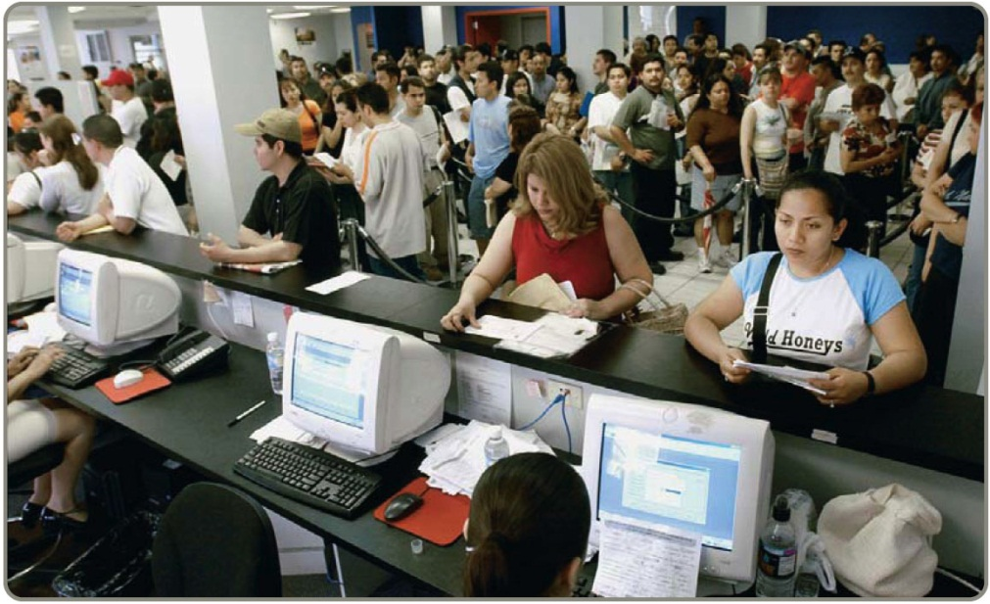
Other Queuing Approaches
The single-phase models cover many queuing situations
Variations of the four single-phase systems are possible
Multiphase models
exist for more
complex situations

Slide 51

All rights reserved. No part of this publication may be reproduced, stored in a retrieval system, or transmitted, in any form or by any means, electronic, mechanical, photocopying, recording, or otherwise, without the prior written permission of the publisher.
Printed in the United States of America.

